Slide 1
DOMAIN: MOBILE APPLICATION DEVELOPMENT TITLE: FeelSafe
PANIMALAR ENGINEERING COLLEGE
B.E.COMPUTER SCIENCE AND ENGINEERING
21CS1512-SOCIALLY RELEVANT MINI PROJECT
By
A.REEMAAASMIN(211422104390)
A.RISHALINI IRIEN(211422104396)
Mentor
Dr.M.S.Vinmathi

Slide 2
Abstract
Our proposed app provides a comprehensive platform for individuals to manage their mental health by anonymously sharing their feelings with empathetic listeners and connecting with a supportive community focused on mental wellness. Through anonymous sharing, users can express their emotions without fear of judgment while benefiting from community-driven support, access to professional mental health resources, and robust privacy measures that ensure confidentiality. By fostering empathy and connection, the app empowers users in their mental well-being journey, promoting a safe and positive environment where they can seek support, report inappropriate behavior, and access tailored mental health resources

Slide 3
Introduction
FeelSafe is a comprehensive mental health support platform designed to empower users by providing a safe space for anonymously sharing their emotions. It offers robust privacy features, community support, access to professional mental health resources, and tools to report inappropriate behavior. The app uses AI-driven analytics and push notifications to track user well-being and provide timely support, helping individuals on their journey to mental wellness in a secure, judgment-free environment.

Slide 4
Development Environment
Hardware Requirements:
RAM: 8 GB
Processor: Intel Core i5 or equivalent
Storage: 10 GB free space
Testing Device: Android phone
Software Requirements:
IDE: Android Studio
Languages: Kotlin (Frontend), Java (Backend)
Cloud Services: Firebase (Firestore, Authentication, Cloud Messaging)
Testing: Android Emulator, Physical Android Device

Slide 5
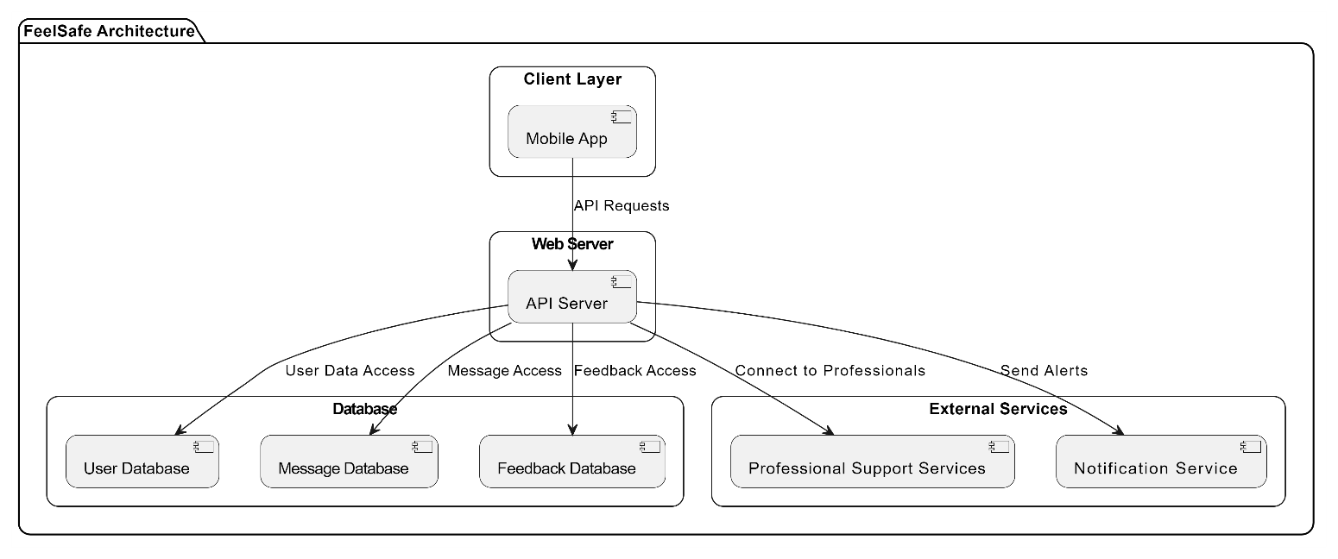
Architectural Diagram

Slide 6
Existing Model
The existing mental health app ecosystem encompasses a variety of solutions designed to support users in managing their mental well-being. Current platforms include self-help apps like Headspace and Calm, which offer mindfulness and meditation practices; therapy apps such as BetterHelp and Talkspace, providing access to licensed therapists for online counseling; and mood tracking apps like Daylio and Moodfit, which allow users to monitor their emotional states and daily activities. Additionally, crisis management apps like Crisis Text Line offer immediate support for individuals in distress. While these systems provide valuable tools for mental health, they often focus on either structured professional support or general wellness, with varying degrees of anonymity, community engagement, and privacy measures.

Slide 7
Proposed Model
The mental health support app is designed to offer a secure and anonymous platform where users can express their emotions freely while ensuring a peaceful and supportive environment. It allows individuals to share their feelings without disclosing their identities, backed by robust data protection to safeguard their privacy. It also includes professional support elements and crisis assistance. Progress monitoring tools and user feedback mechanisms are integrated to continually enhance the app’s features and user experience.To maintain a respectful environment, if a user receives three reports against their account, the app should automatically review and potentially terminate that user’s account to ensure community safety and integrity.Overall, the app aims to create a secure, anonymous, and supportive space for managing mental health while fostering a constructive community atmosphere.

Slide 8
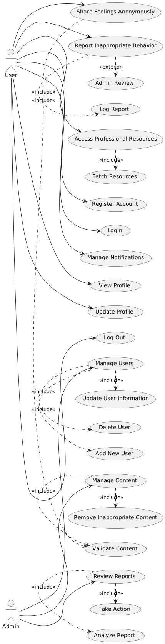
Use Case Diagram

Slide 9
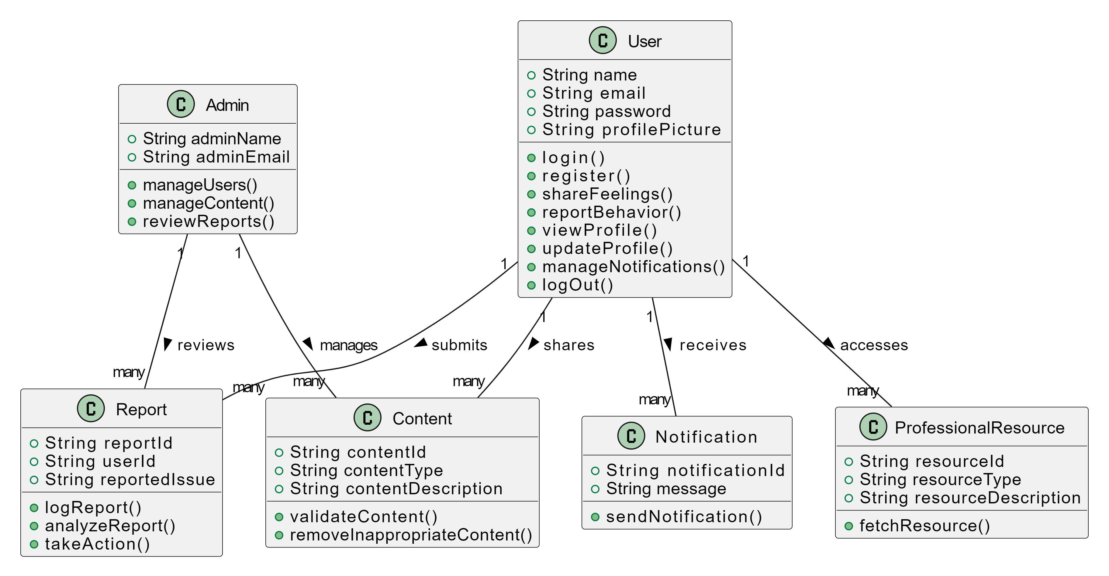
Class Diagram

Slide 10
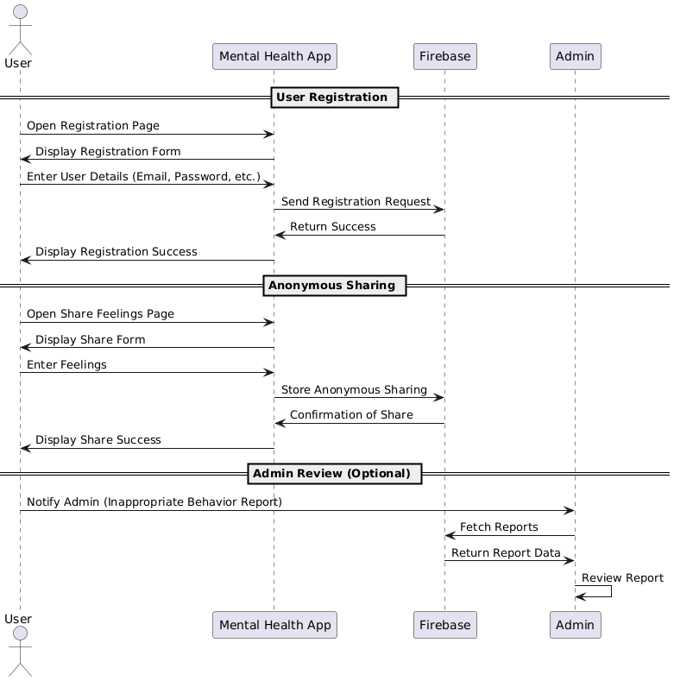
Sequence Diagram

Slide 11
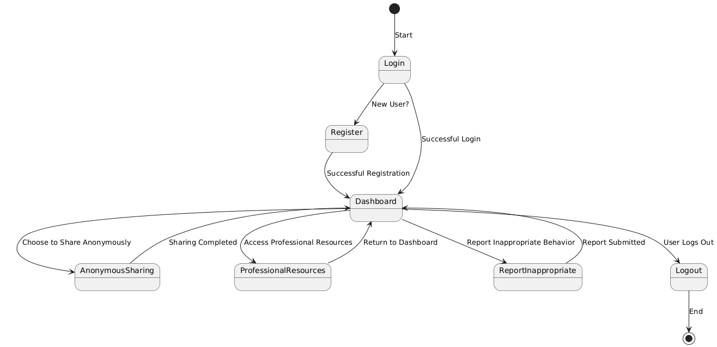
State Chart Diagram

Slide 12
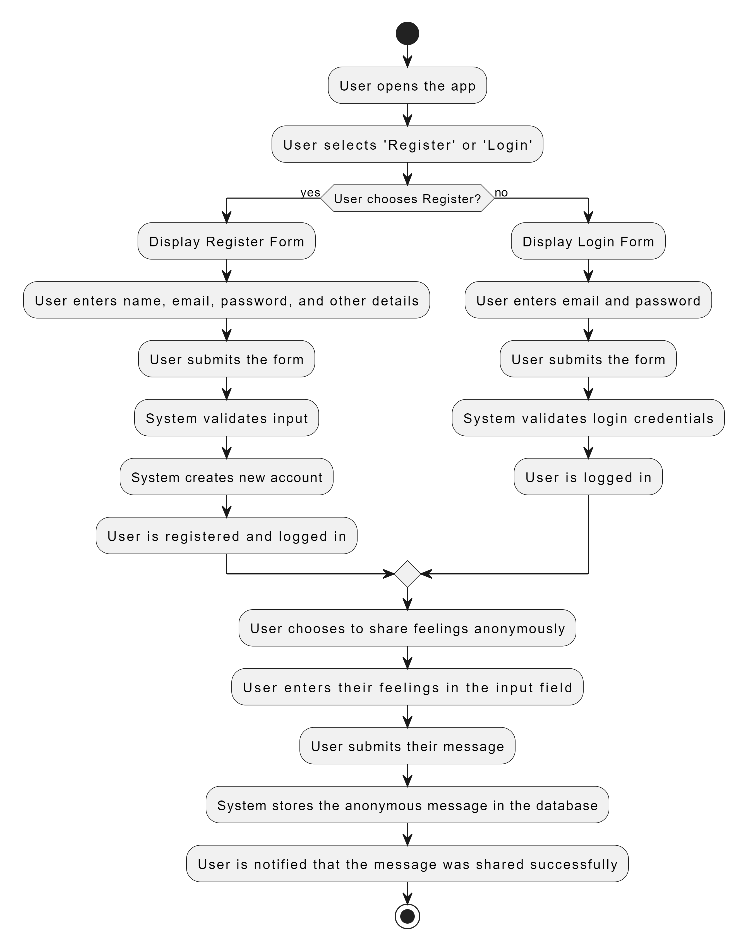
Activity Diagram

Slide 13
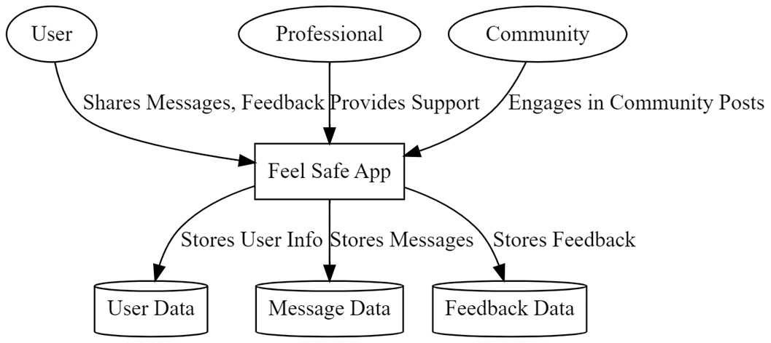
Data flow diagrams
Data Flow Diagram Level 0

Slide 14
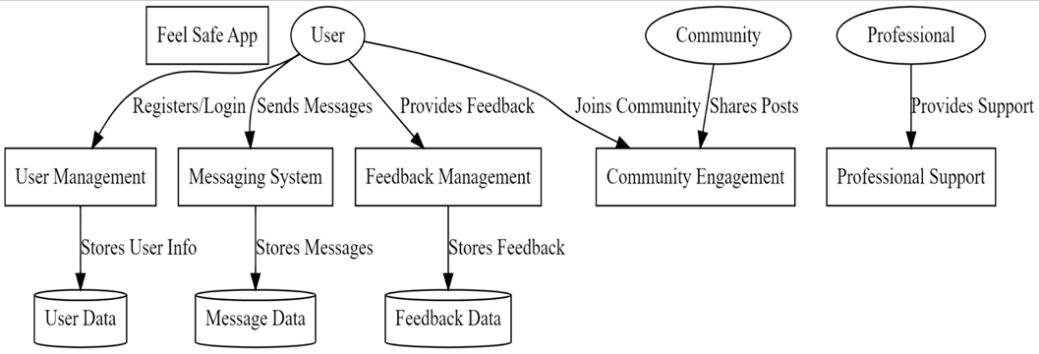
Data Flow Diagram Level 1

Slide 15
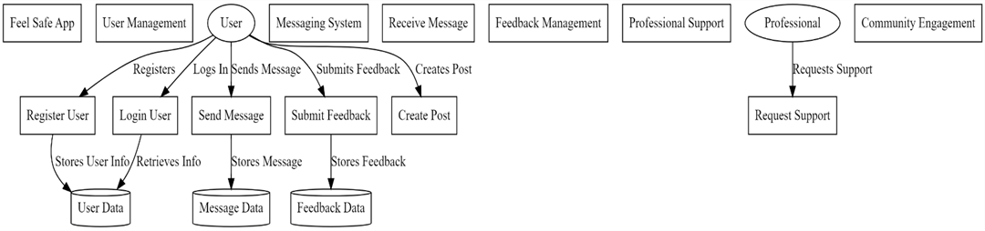
Data Flow Diagram Level 2

Slide 16
Module Descriptions
FeelSafe consists of 6 main modules. They are,
User Management Module
Messaging Module
Feedback Management Module
Professional Support Module
Notification Module
Security and Privacy Module

Slide 17
User Management Module
It is fundamental, enabling users to register, authenticate, and manage their profiles securely. This module allows for account creation with unique credentials, facilitates seamless login and logout processes, and provides options for users to update their personal information and preferences, ensuring a personalized experience.

Slide 18
Messaging Module
It serves as a vital communication tool, allowing users to share their thoughts and feelings anonymously. This module enables real-time messaging, supporting both private conversations and group discussions. It maintains a history of all messages exchanged, fostering an environment of support and understanding among users. Additionally, users can report any inappropriate content, ensuring the safety and integrity of the communication space.

Slide 19
Feedback Management Module
This Module empowers users to share their experiences and suggestions regarding the app's functionalities. This module features a user-friendly interface for submitting feedback and categorizes responses for analysis, helping the development team identify areas for improvement and enhancement based on user input.

Slide 20
Professional Support Module
It connects individuals with mental health professionals. This module provides access to a directory of available professionals, facilitates appointment scheduling, and offers links to helplines and mental health resources. By doing so,it ensures users can seek the necessary support when needed, reinforcing the app's commitment to mental wellness.

Slide 21
Notification Module
It plays a crucial role in keeping users engaged and informed. It manages alerts for new messages, feedback responses, and important updates, allowing users to customize their notification preferences. This ensures that users stay connected without feeling overwhelmed by unnecessary alerts.

Slide 22
Security and Privacy Module
The paramount in protecting user data. It implements robust security measures, including two-factor authentication and data encryption, ensuring that personal information and messages remain confidential. Users have control over their privacy settings, allowing them to determine their visibility within the app while ensuring compliance with data protection regulations.

Slide 23
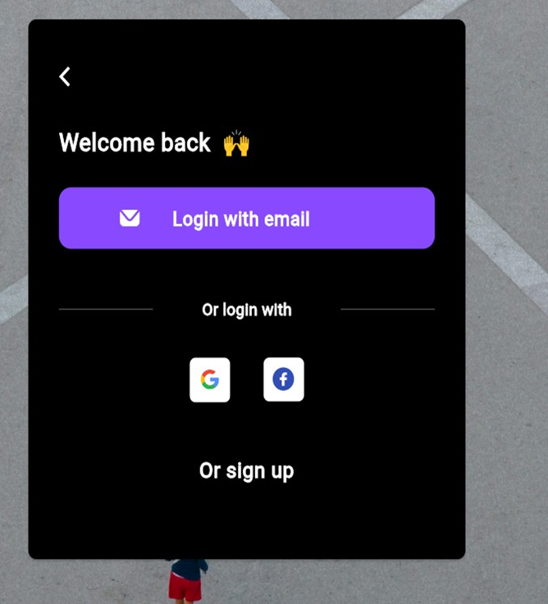
Home page

Slide 24
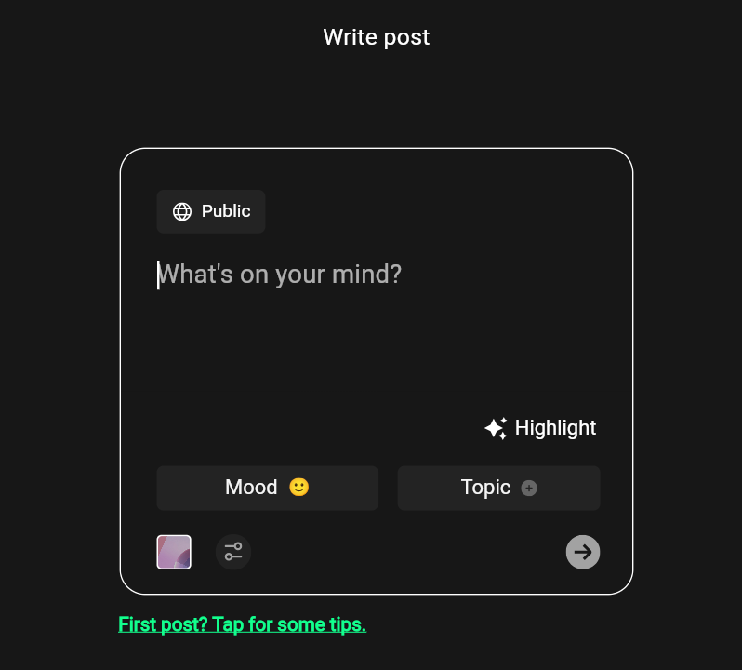
Messaging Module

Slide 25
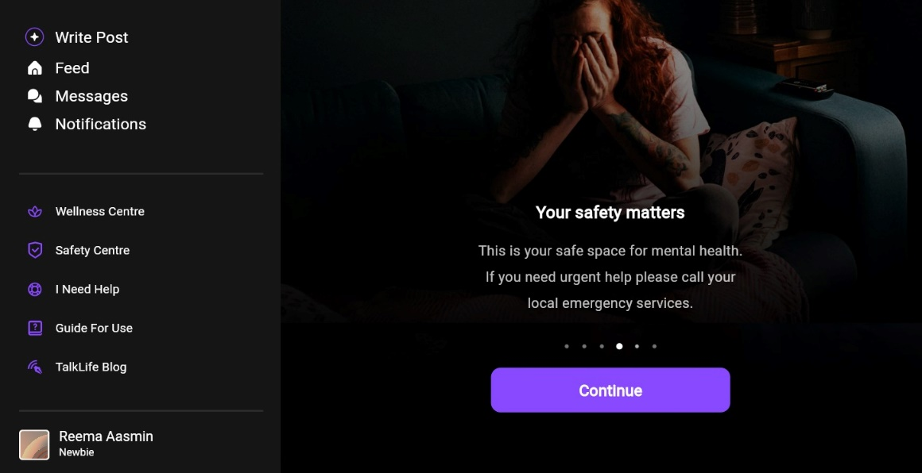
Professional Support Module

Slide 26
Conclusion
The FeelSafe App provides a robust platform for users to manage their mental health by fostering anonymous communication, community support, access to professional resources, and maintaining security and privacy. The app meets its core objectives of providing a safe and supportive environment for users to express their emotions and seek help while safeguarding their personal data.The app’s intuitive user interface, ease of use, and thoughtful design ensure that users can engage with the platform with minimal friction. By successfully incorporating anonymous sharing, feedback loops, and professional assistance, the app delivers on its promise of fostering empathy and community support.

Slide 27
Future Enhancements
Advanced AI-based Emotional Support: Integrating AI-driven sentiment analysis can provide personalized support based on the user’s emotional state. AI-based recommendations can also be given to improve mental health through content like meditation techniques or self-help articles.
Real-time Therapy Sessions: Expanding the professional support module to include real-time video or chat therapy sessions with mental health professionals would provide immediate assistance to users in need.
Multilingual Support: Implementing multilingual features would expand the app's reach to non-English speaking users, making it accessible to a global audience.
Increased Community Features: Implementing features such as group discussions, peer support groups, and topic-based forums could foster deeper community interaction and support.

Slide 28
References
[1] Olivia Oswald Lim, David Habsara Hareva,Eden Steven,Dionysius Sentausa,Frentsen Adeputra Abineno Companion: Mental Health Mobile Applications for Students.IEEE Nov 2022.
[2]E.S Mendis, L.W Kasthuriarachchi, H.P.K.L Samarasinha, Sanvitha Kasthuriarachchi, Samantha Rajapaksa ‘Mobile Application for Mental Health Using Machine Learning’, IEEE Nov 2022.
[3] Malaika Samuel; C.P. Shirley,"Mindset, An Android-Based Mental Wellbeing Support Mobile Application. IEEE Oct 2023.
[4] Shiqi Yang, Ping Zhou2, Kui Duan3, M. Shamim Hossain, MohammedF. Alhamid.”emHealth: Towards Emotion Health Through Depression Prediction and Intelligent Health Recommender System”.
[5] Shagun Saboo; Srishti Gupta; Isha Nailwal; Rithik Gandhi; Sameer Rana. “Diagnosing Mental Health Patient While Maintaining Anonymity”.IEEE Dec 2021.

Slide 29
THANK YOU

